Slide 1

Sales Effectiveness:
Use, Benefits, and Pitfalls
(Part 2)
National Association of
Motor Vehicle Boards and Commissions
2016 Fall Workshop
Joseph F. Roesner The Fontana Group Tucson, AZ | Sharif Farhat Urban Science Detroit, MI

Slide 2
Introduction – Fontana Group
Based in Tucson, Arizona
Founded in 1973
Retail Automotive Industry Emphasis
  Dealers and Dealer groups
  Heavy Trucks
  Motorcycles
  Other Industries
  Rigorous Empirical Analysis
  Statistical and Economic analysis

Slide 3
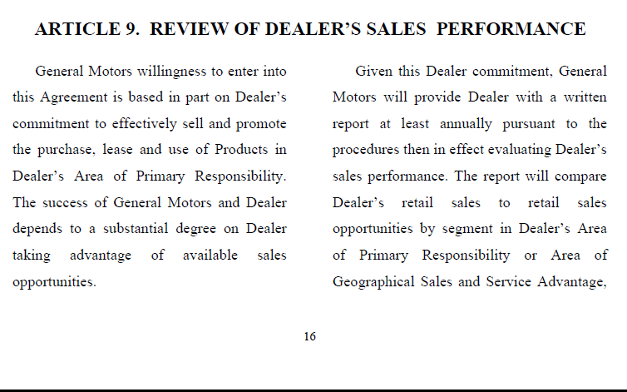
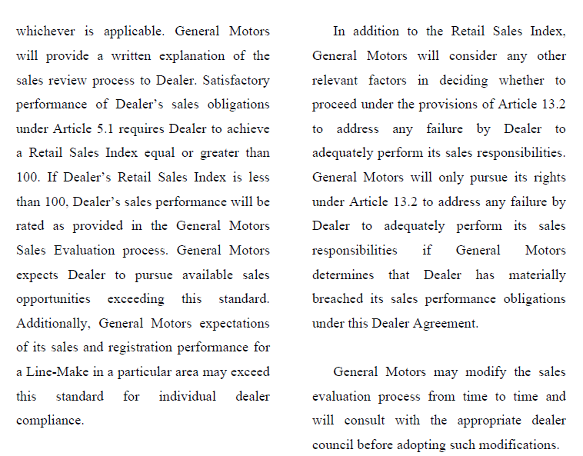
GM Performance Standard

Slide 4
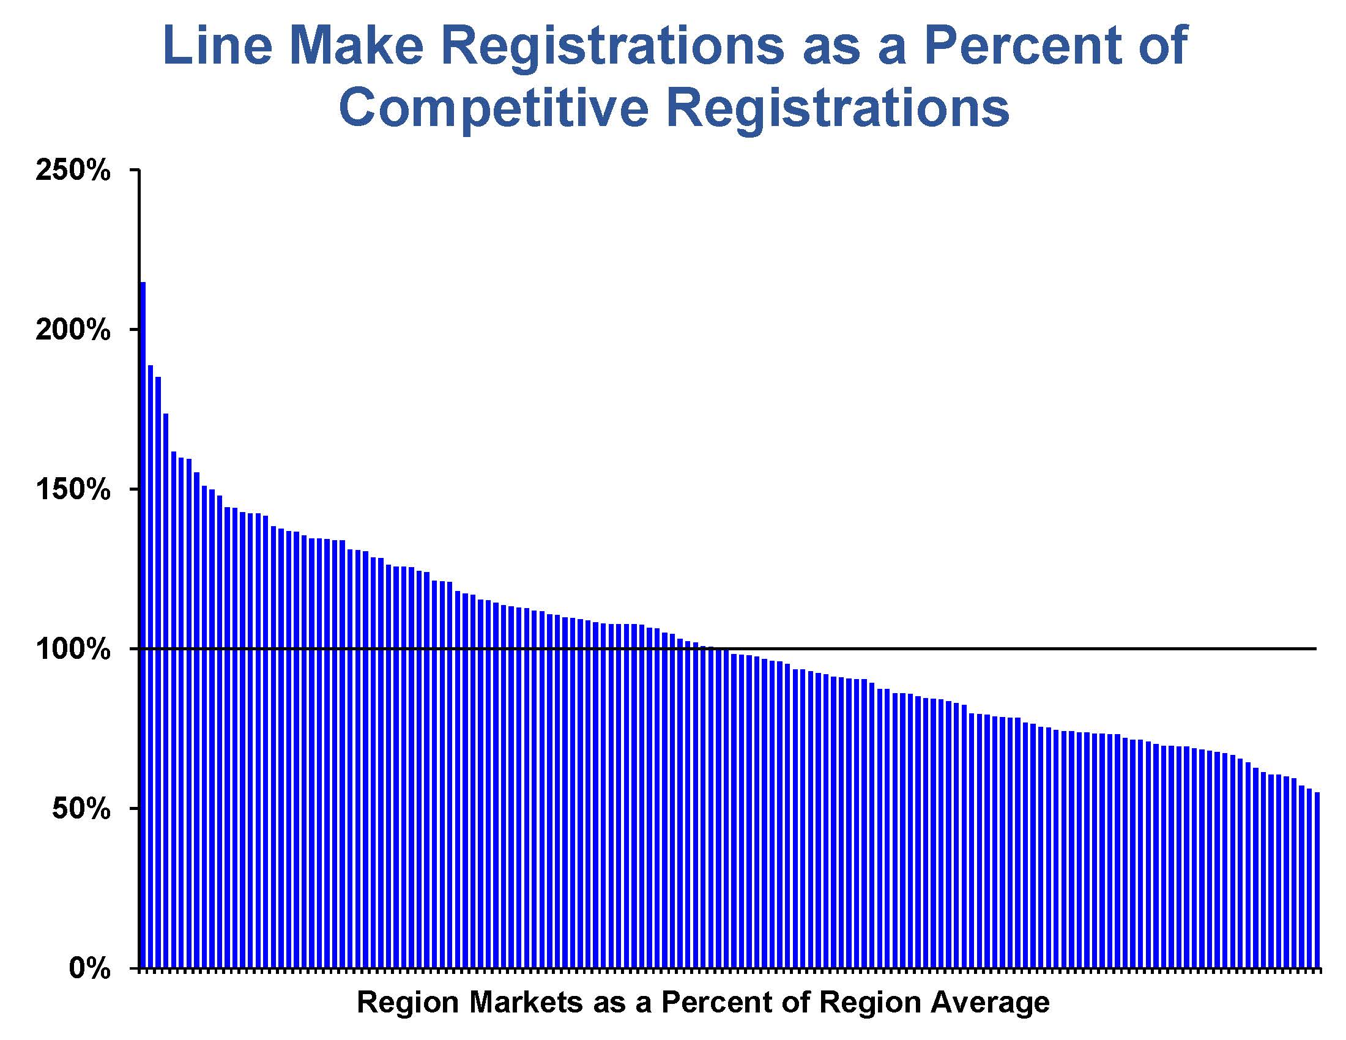

Slide 5
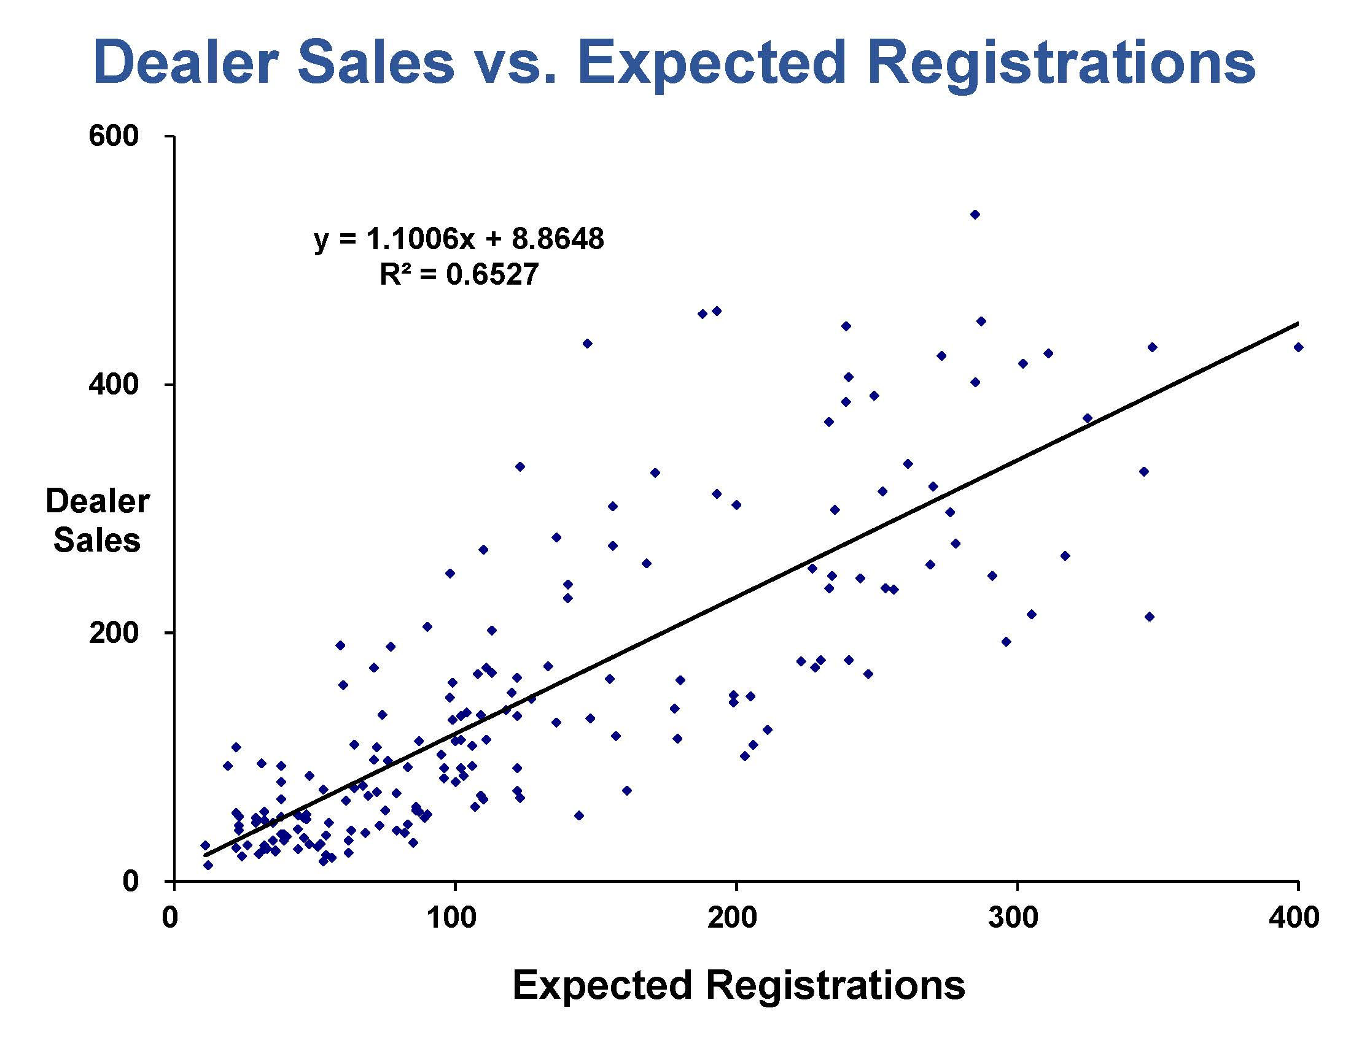

Slide 6
Mathematical reality: everyone can’t be above average
Welcome to Lake Wobegon,
where all the women are strong,
all the men are good-looking
and all the children are above-average.
Garrison Keillor

Slide 7
Introduction – Urban Science
Founded 1977
Over 900 professionals globally
Automotive focus
Dealer operations → business management
Consumer engagement → bang for buck
Dealer network planning
  Number / Location / Performance
  Sales effectiveness

Slide 8
Sales Effectiveness Ratings
Dealer performance varies
Any measure must be consistent
Any reasonable measure will show variation
  good / average / bad / worst
Objectively assess dealer concerns
Improving performance benefits all
  consumers / dealer / OEM
Reasonable for OEMs to assess and manage performance
  Dealers are the only option for new vehicle sales

Slide 9
Sales Effectiveness Typical Concerns
PMA definition
Imprecise/Incorrect Segmentation
Topography/Climate
Economic conditions
Demographic bias (income/age/ethnicity/etc.)
Factory / other brand bias (i.e., import/domestic)
Number / strength of inter-brand competitors
Incentive bias (i.e., lease vs buy)
Advertising bias
Commuting pattern bias
Allocation “Can’t sell them if I don’t have them”

Slide 10


PMA Definition
Definition of a PMA:
geographic area in which a dealer enjoys a competitive advantage over all other same-line dealers due solely to geographic factors
Example PMAs shown

Slide 11
RMA not necessarily PMA
Definition of RMA (Relevant Market Area)
Circle of specified radius
Larger of dealer contract area or circle
“Community or territory” (Florida) or “the Market” (Texas) must be developed for each analysis
10 Mile Radius RMA Example
Example PMAs shown

Slide 12
PMA Definition
How are PMAs properly constructed?
By developing their geographic boundaries using an objective and systematic.
Two step process for creating PMAs:
  Initially assign geographic units to the nearest dealer.
  Adjust for natural and man-made barriers, traffic patterns, and shopping habits.
Final PMA Definition
Drive Distance
Consumer Behavior
Drive Time
Air Distance
=

Slide 13
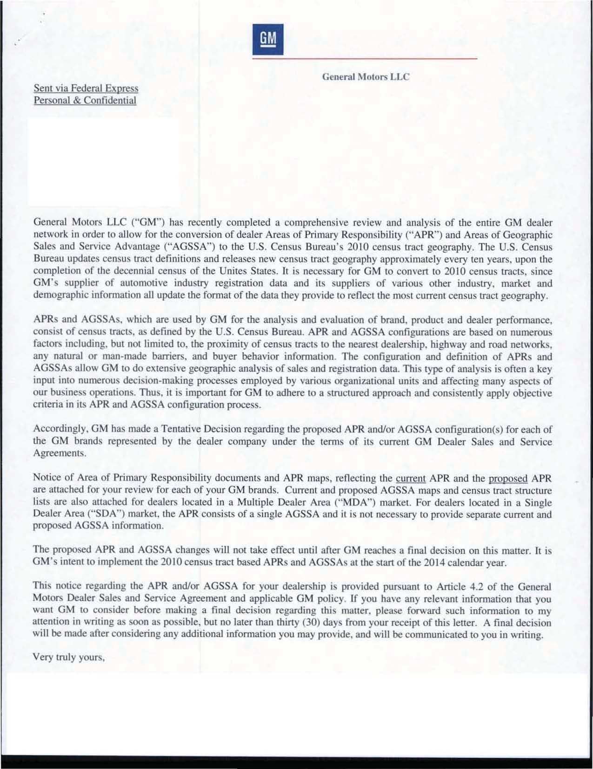
“APRs and AGSSAs, which are used by GM for the analysis and evaluation of brand, product, and dealer performance, consist of census tracts as defined by the U.S. Census Bureau. APR and AGSSA configurations are based on numerous factors including, but not limited to, the proximity of census tracts to nearest dealership, highway and road networks, any natural or man-made barriers, and buyer behavior information.”

Slide 14
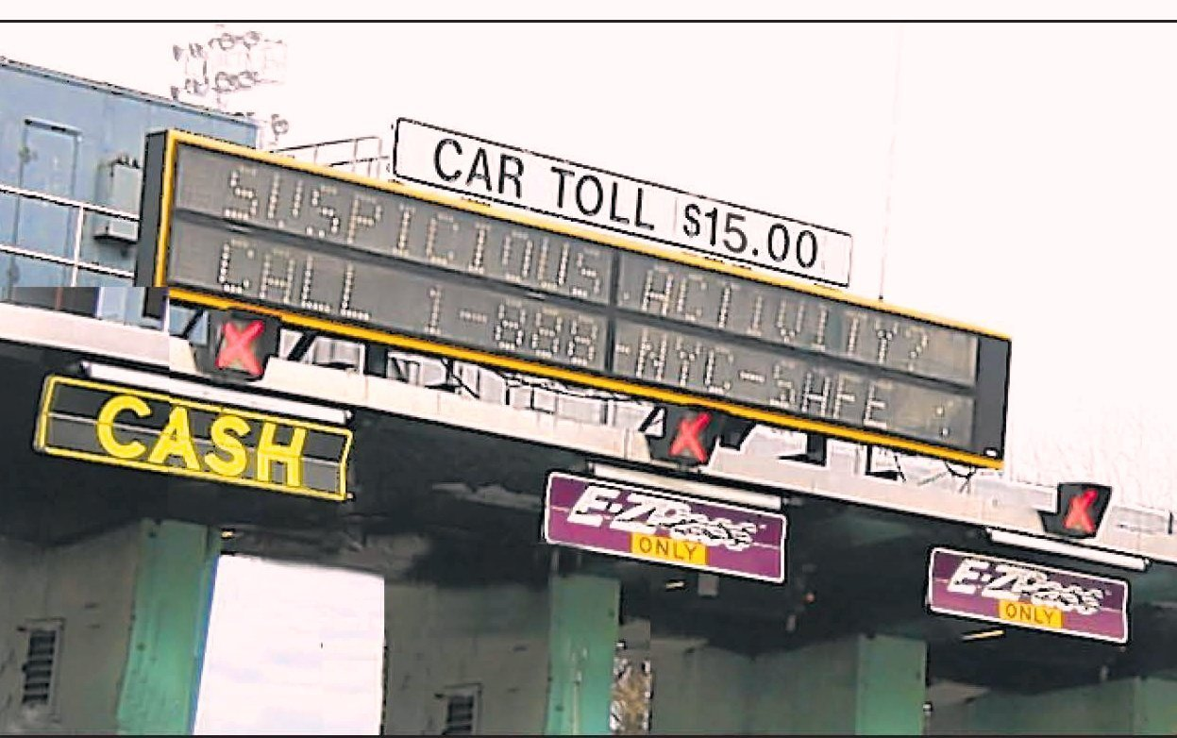

Slide 15
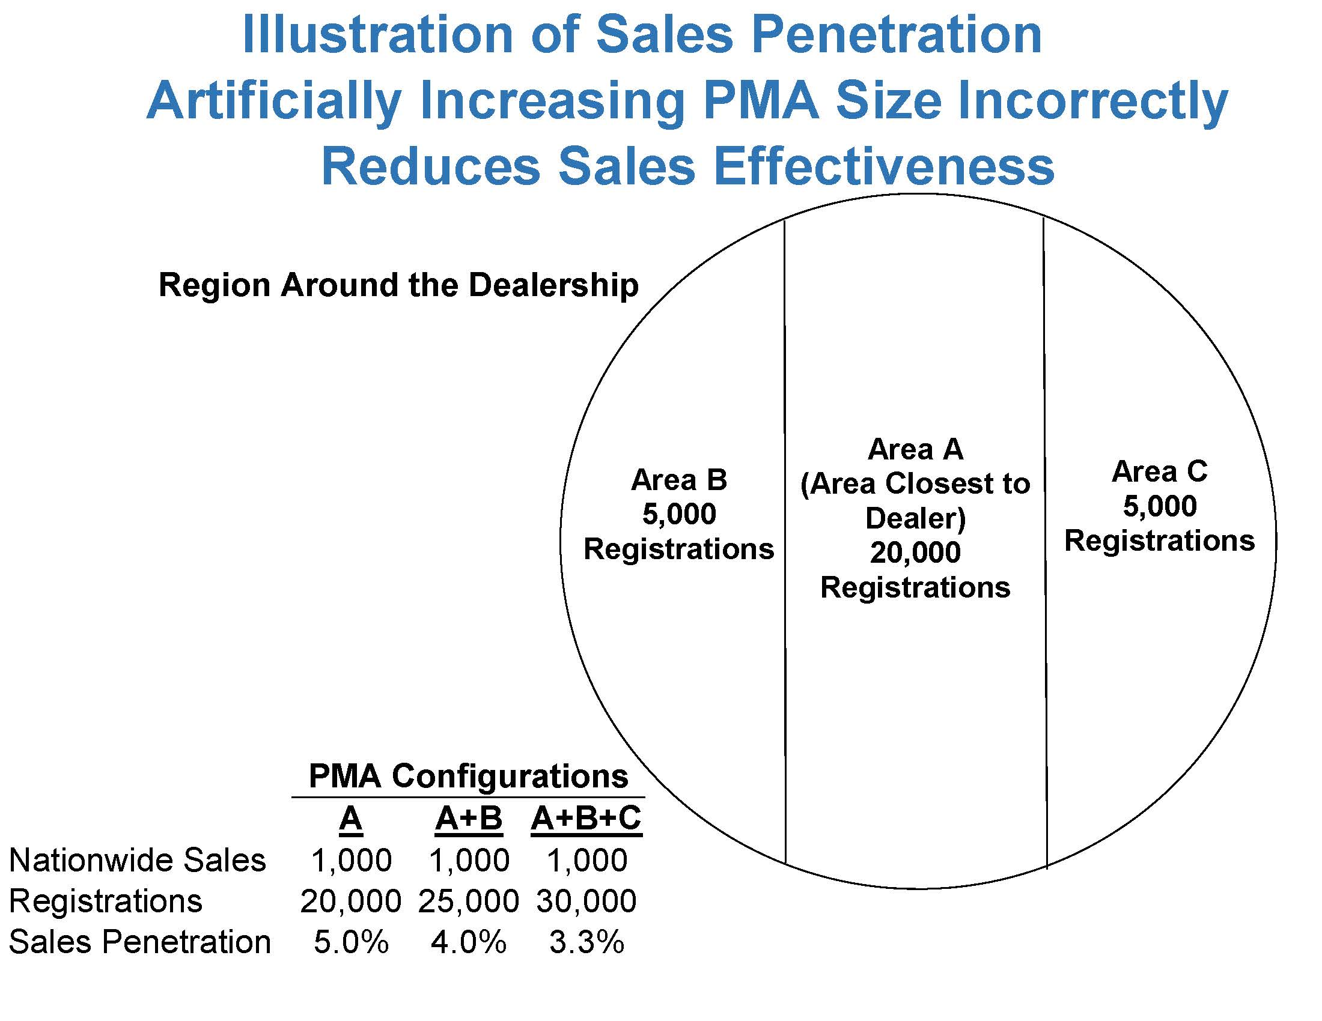

Slide 16
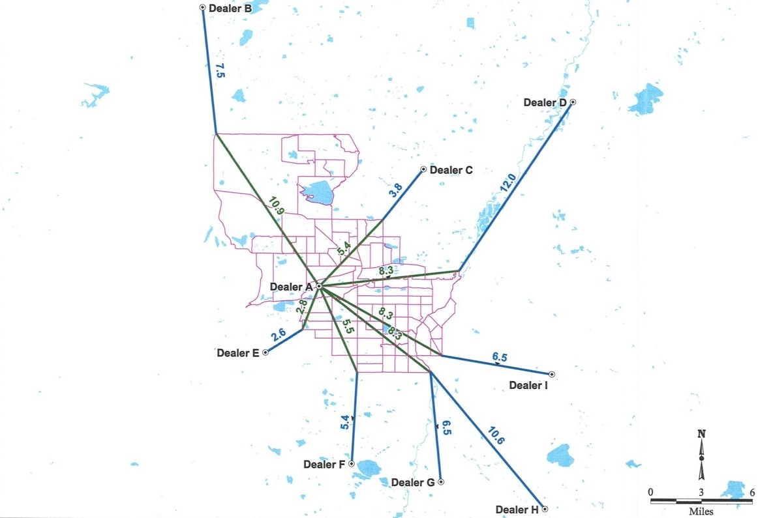
Air Distance in Miles from Dealer A and Surrounding
Same Linemake Dealer Locations to APR Census Tracts

Slide 17
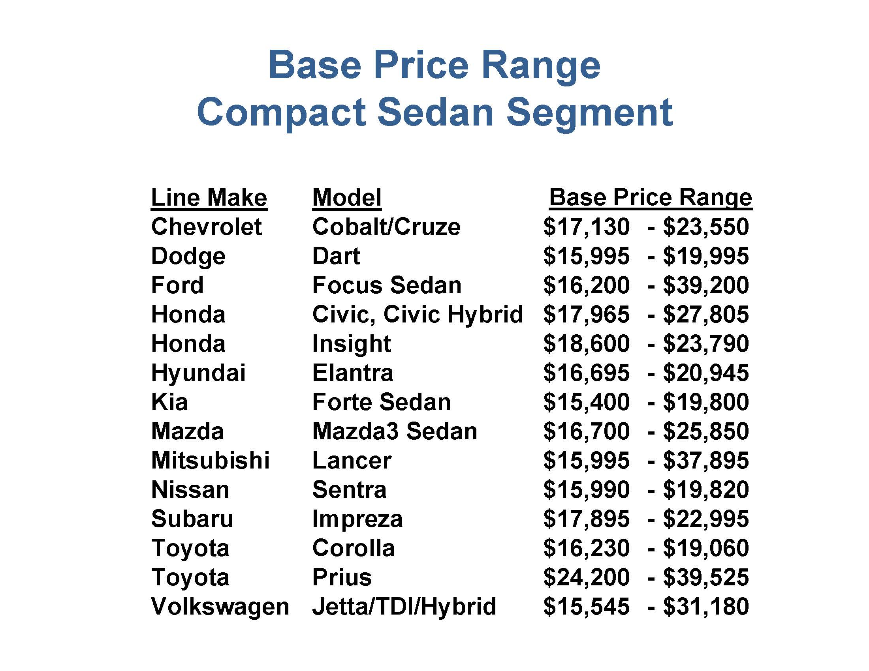

Slide 18


Slide 19
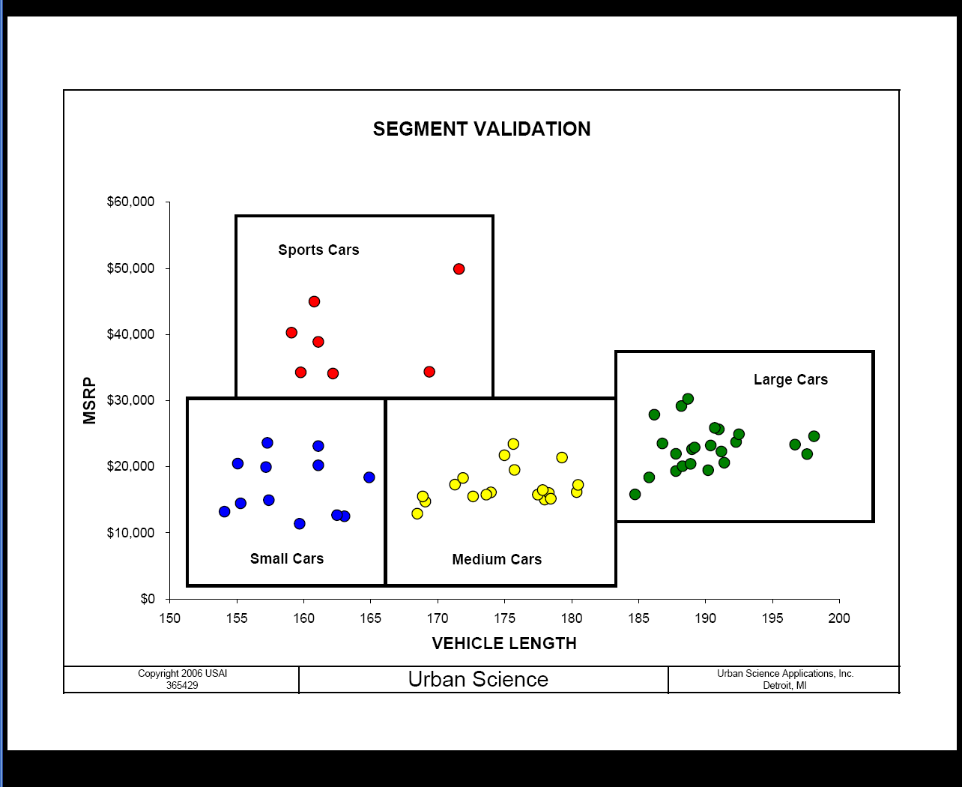
Segment Validation

Slide 20
Economic Conditions – Segmentation adjustment

Slide 21
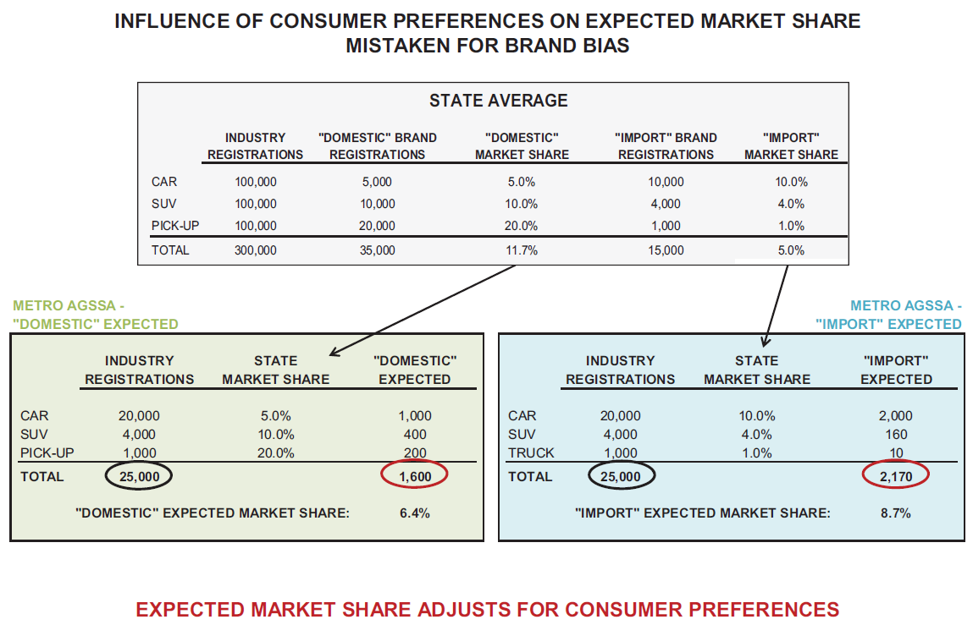
Brand Bias: “Import / Domestic” Bias

Slide 22
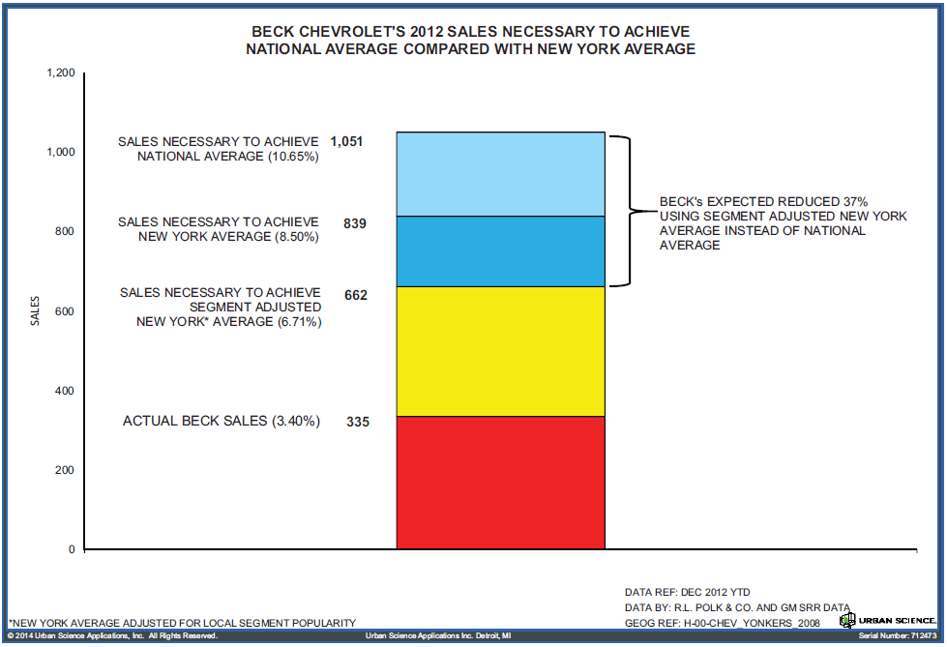
Beck Chevrolet – Segmentation adjustment

Slide 23
Objective Verification
US District Court, Southern District of New York
Beck Chevrolet v. General Motors, September 2013
Judge Hellerstein:
  “GM uses other indices to check … its dealers’ performance … If imports are, as Beck argues, a major impediment to measuring its performance, that should be true equally to the Ford dealer and the Chrysler dealer, but GM shows statistically that that is not so and it is outperformed by Ford and Chrysler in its AGSSA.”

Slide 24
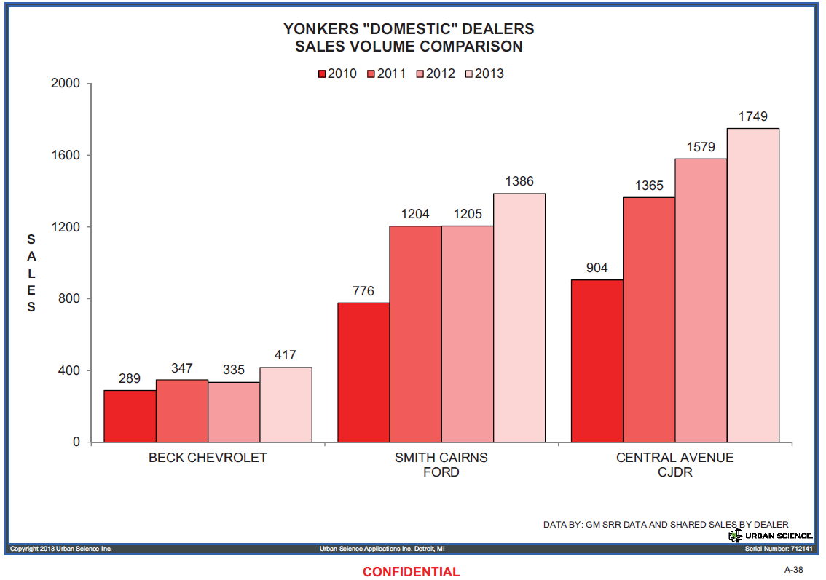
Beck Chevrolet – Import Bias?

Slide 25
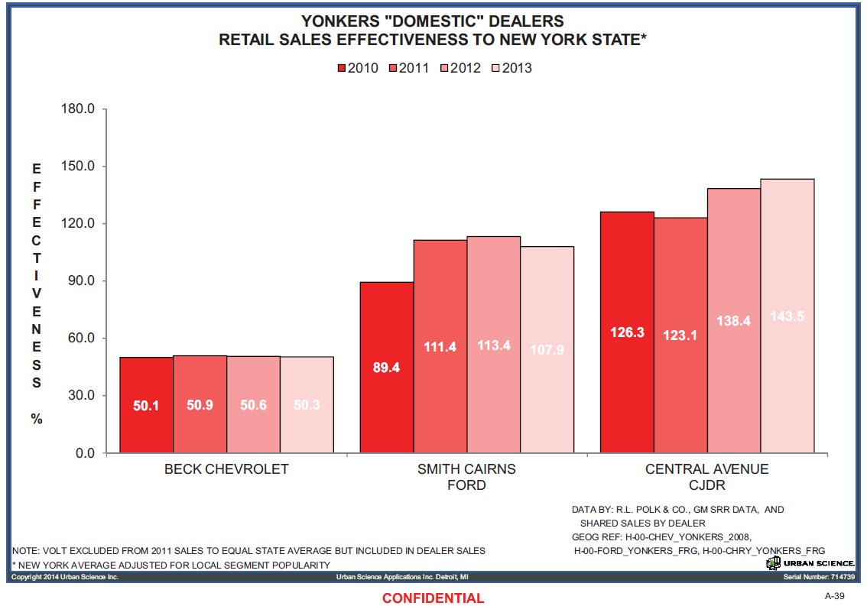
Beck Chevrolet – Import Bias?

Slide 26
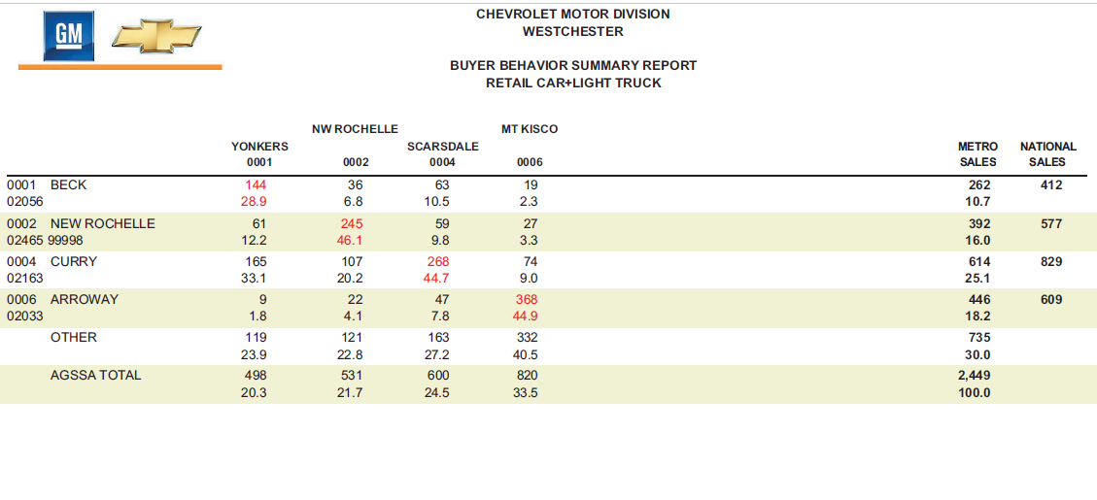
Beck Chevrolet – Import Bias?

Slide 27
Factory Bias – Normalize Registrations
Confirm factory bias exists
  What level of performance is anomalous?
Confirm factory bias is negatively impacting your sales
  GM in Buffalo
“Normalize”
  Calculate reduction in sales opportunity to account for factory bias

Slide 28
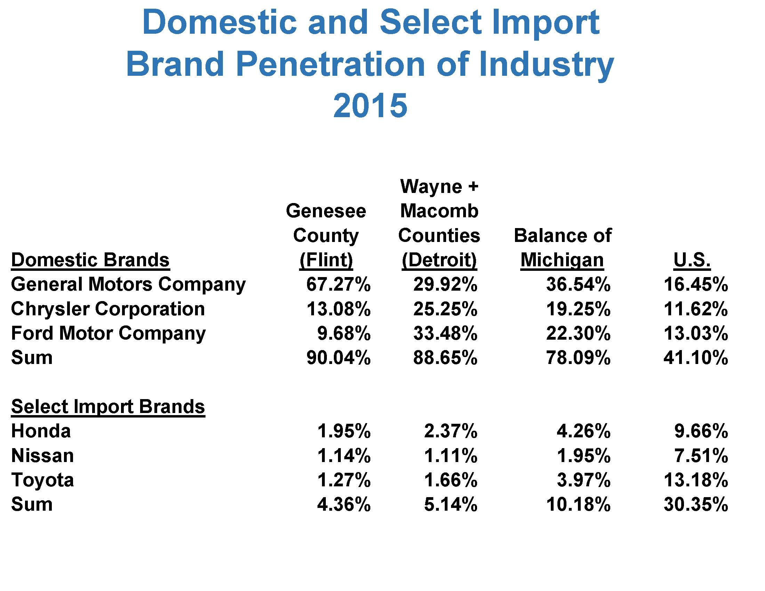

Slide 29
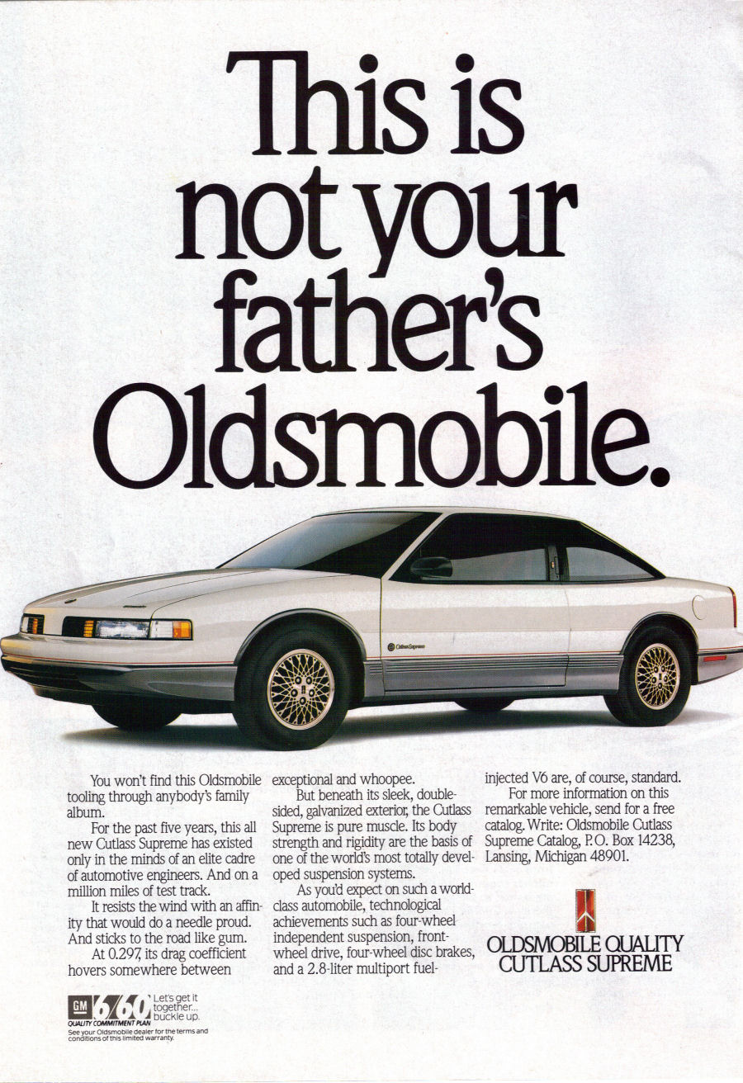

Slide 30
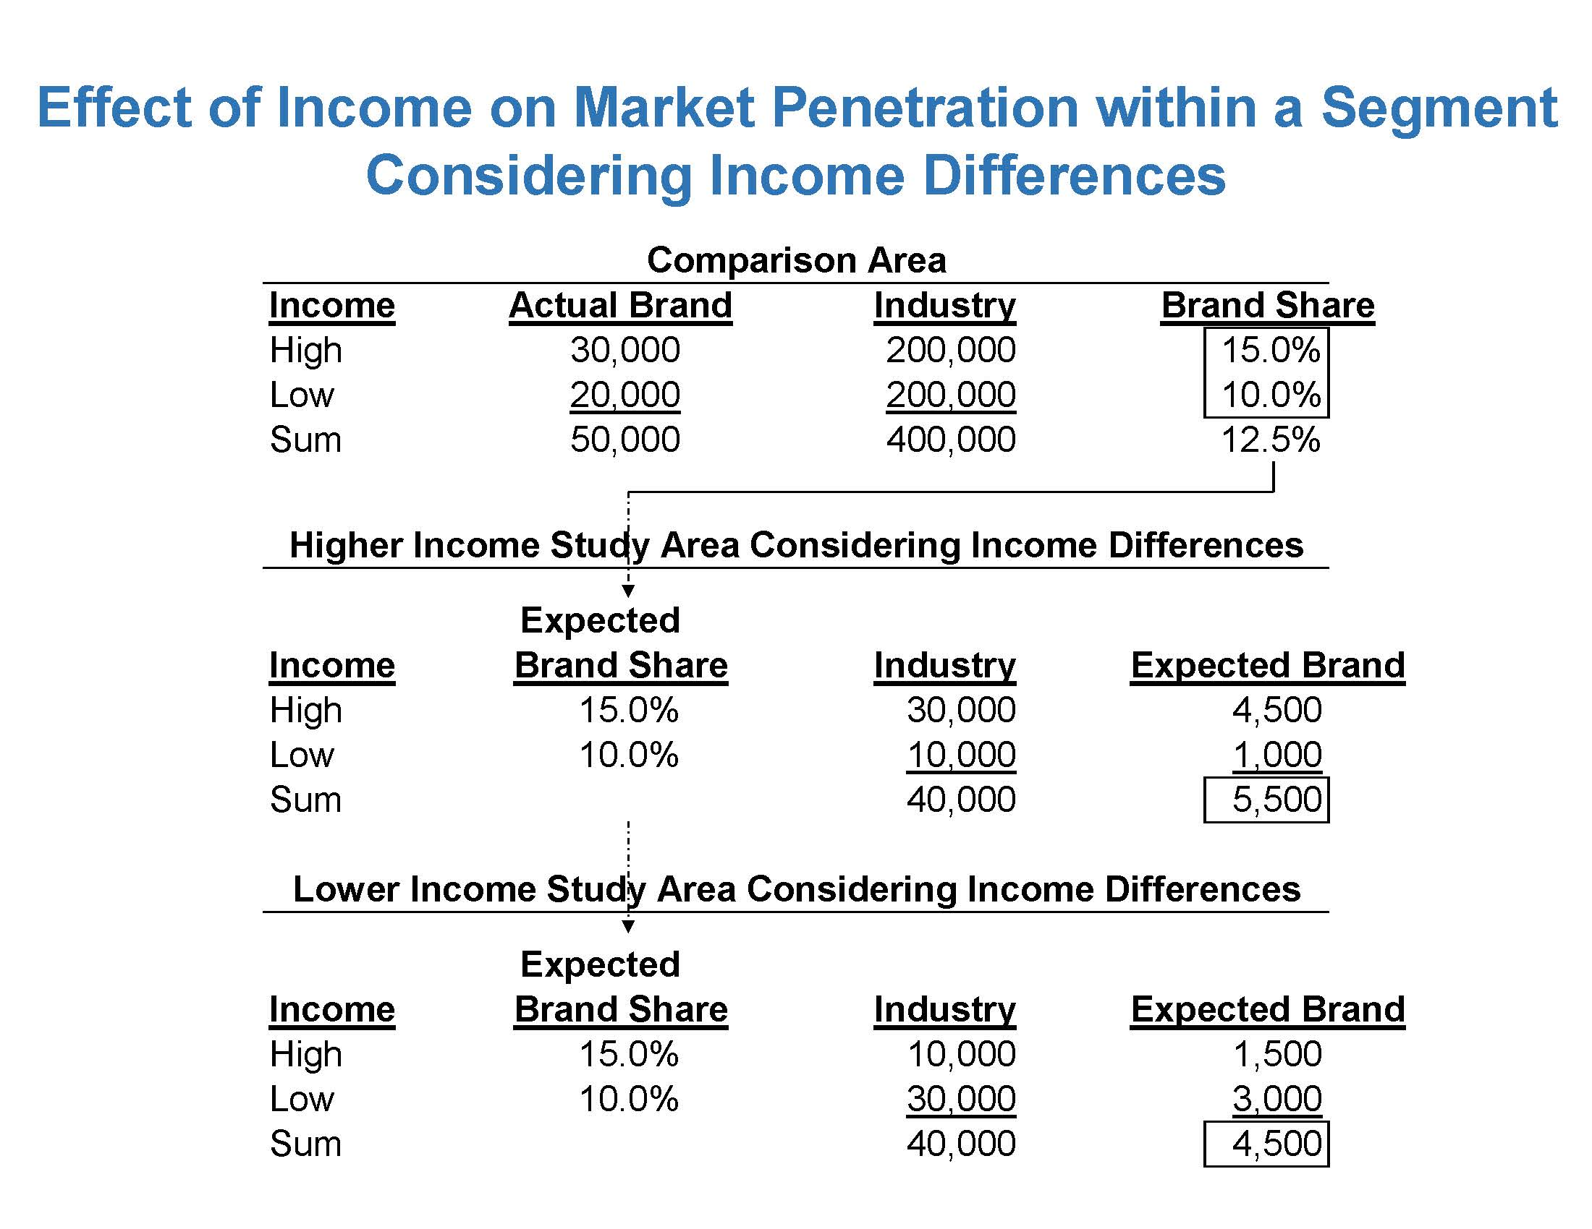

Slide 31
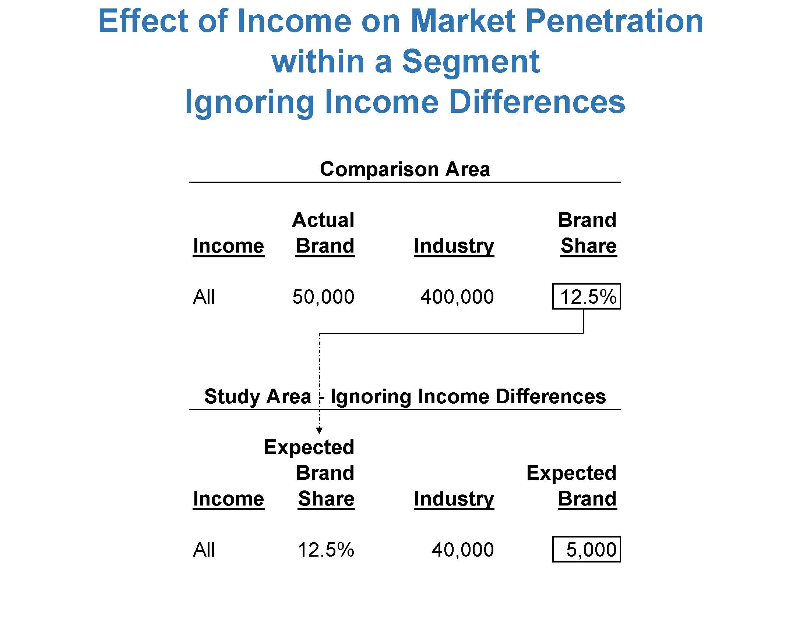

Slide 32
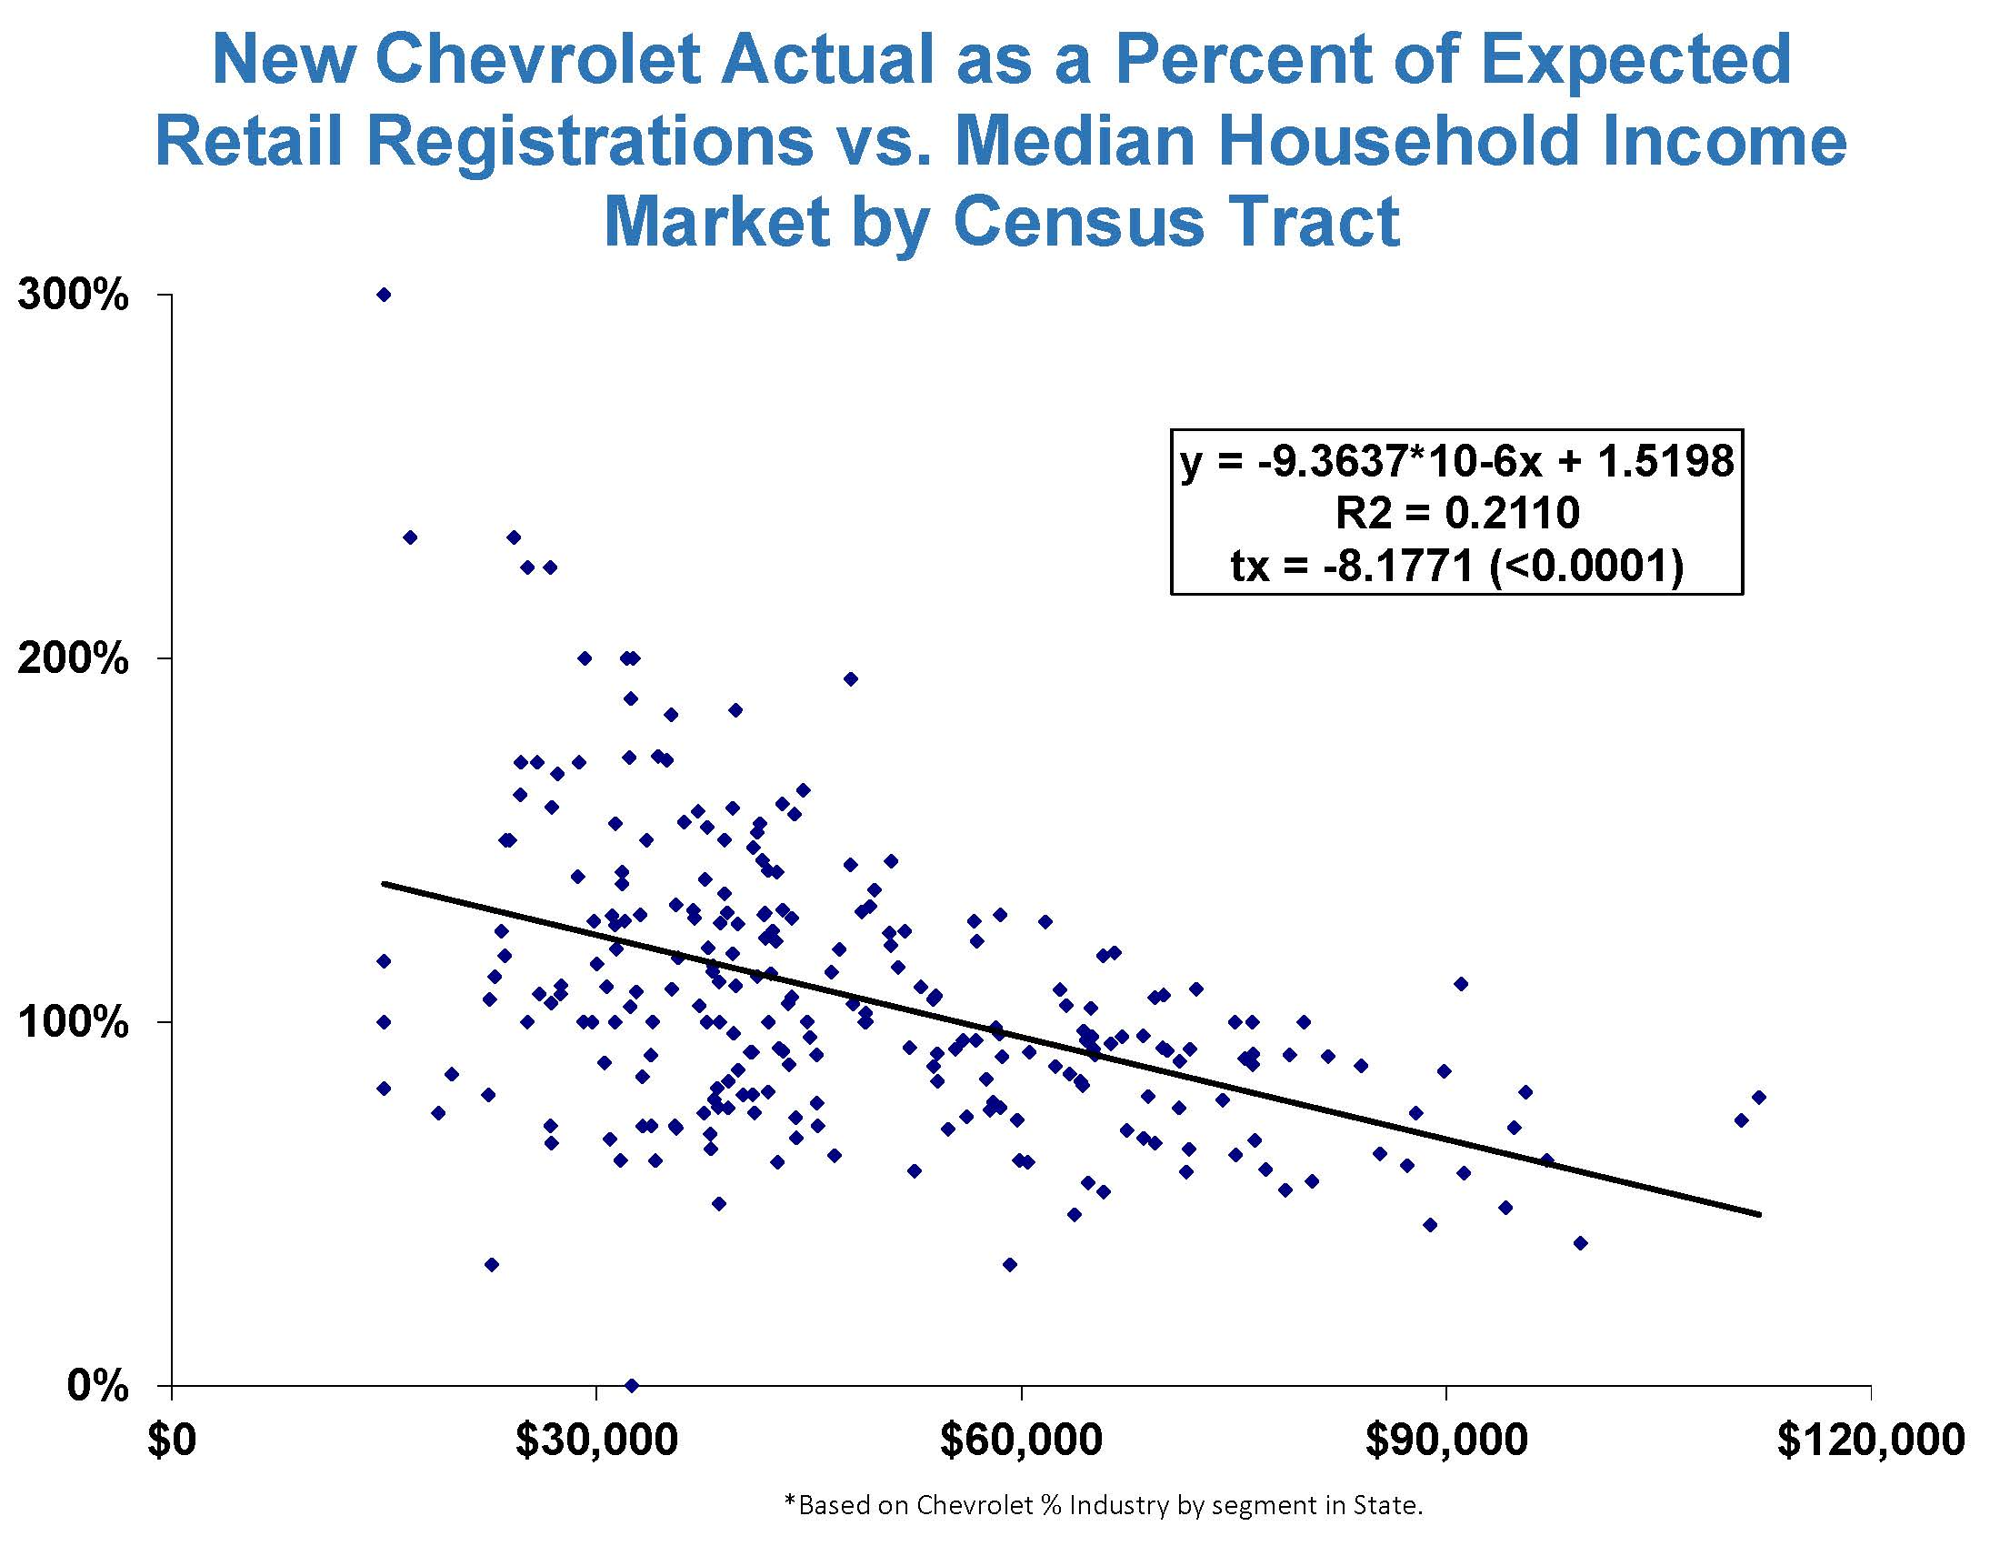

Slide 33
Number of Franchises
Line Make | Metro | State | Metro % State |  | Line Make | Metro | State | Metro % State
Chevrolet | 3 | 71 | 4.2% |  | Jaguar | 1 | 2 | 50.0%
Ford | 3 | 63 | 4.8% |  | Kia | 1 | 6 | 16.7%
Buick | 2 | 57 | 3.5% |  | Lexus | 1 | 1 | 100.0%
Cadillac | 2 | 34 | 5.9% |  | Lincoln | 1 | 25 | 4.0%
Chrysler | 2 | 51 | 3.9% |  | Mazda | 1 | 8 | 12.5%
Dodge | 2 | 50 | 4.0% |  | Mercedes-Benz | 1 | 2 | 50.0%
GMC Truck | 2 | 33 | 6.1% |  | Mitsubishi | 1 | 4 | 25.0%
Jeep | 2 | 49 | 4.1% |  | Nissan | 1 | 10 | 10.0%
Mercury | 2 | 42 | 4.8% |  | Porsche | 1 | 3 | 33.3%
Pontiac | 2 | 57 | 3.5% |  | Saab | 1 | 2 | 50.0%
Saturn | 2 | 4 | 50.0% |  | Scion | 1 | 6 | 16.7%
Acura | 1 | 2 | 50.0% |  | Subaru | 1 | 5 | 20.0%
BMW | 1 | 4 | 25.0% |  | Suzuki | 1 | 6 | 16.7%
Honda | 1 | 9 | 11.1% |  | Toyota | 1 | 15 | 6.7%
Hyundai | 1 | 6 | 16.7% |  | Volkswagen | 1 | 4 | 25.0%
Infiniti | 1 | 1 | 100.0% |  | Volvo | 1 | 1 | 100.0%
Isuzu | 1 | 3 | 33.3%
 |  |  |  |  | Sum | 30 | 536 | 5.6%

Slide 34
Number of Franchises
Fewer / Larger
VS
Greater / Smaller

Slide 35
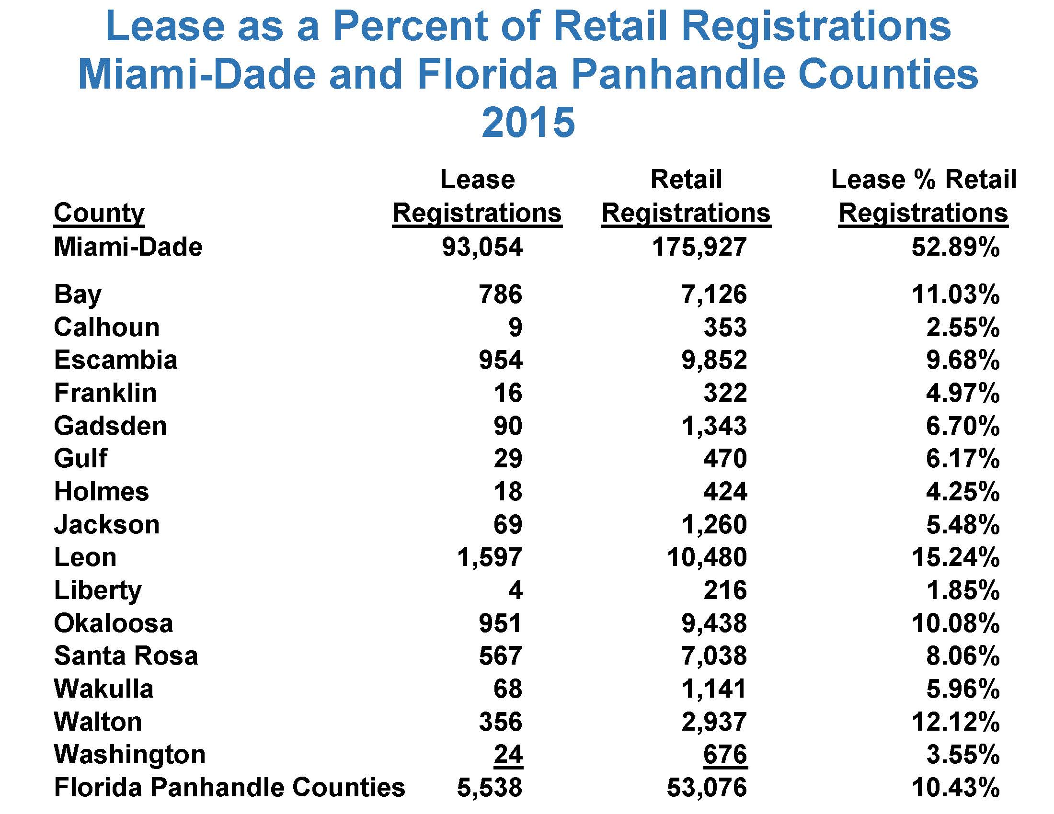

Slide 36
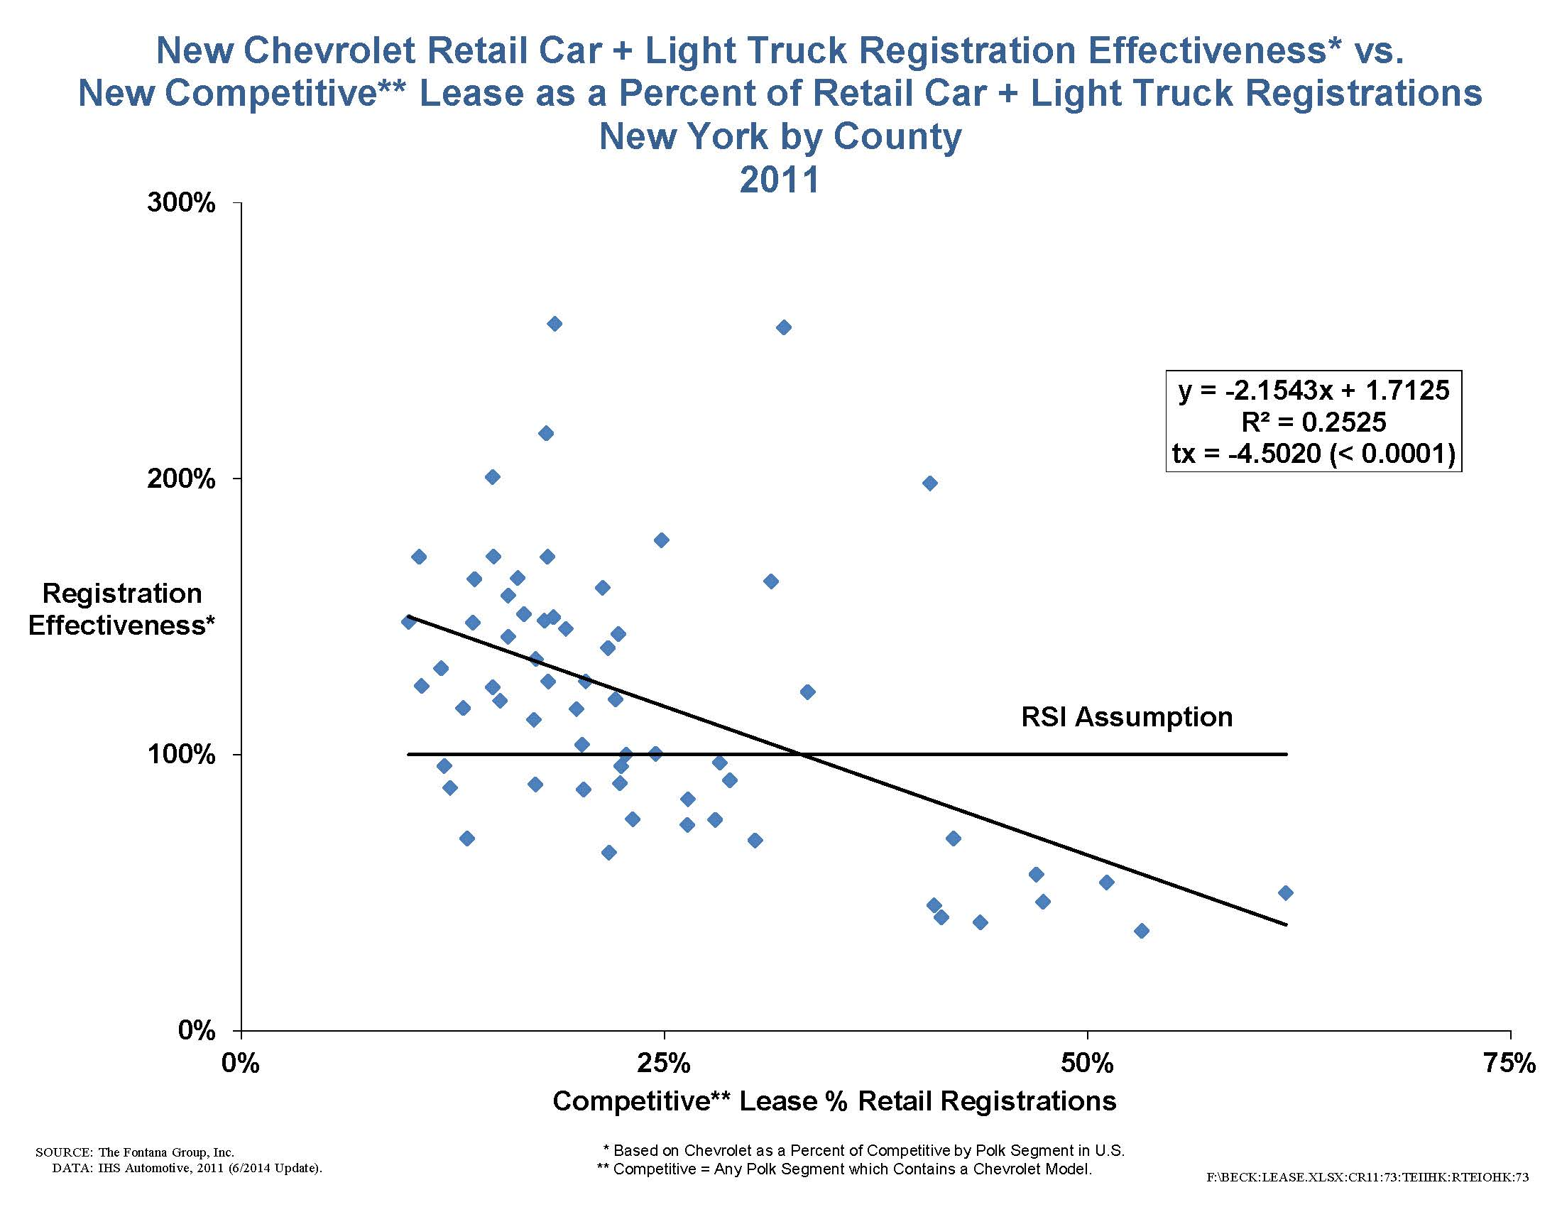

Slide 37
Advertising Bias
Differing Levels of Manufacturer Support
Secondary Markets and Media Coverage
Does National/Regional Advertising Fit the Market

Slide 38
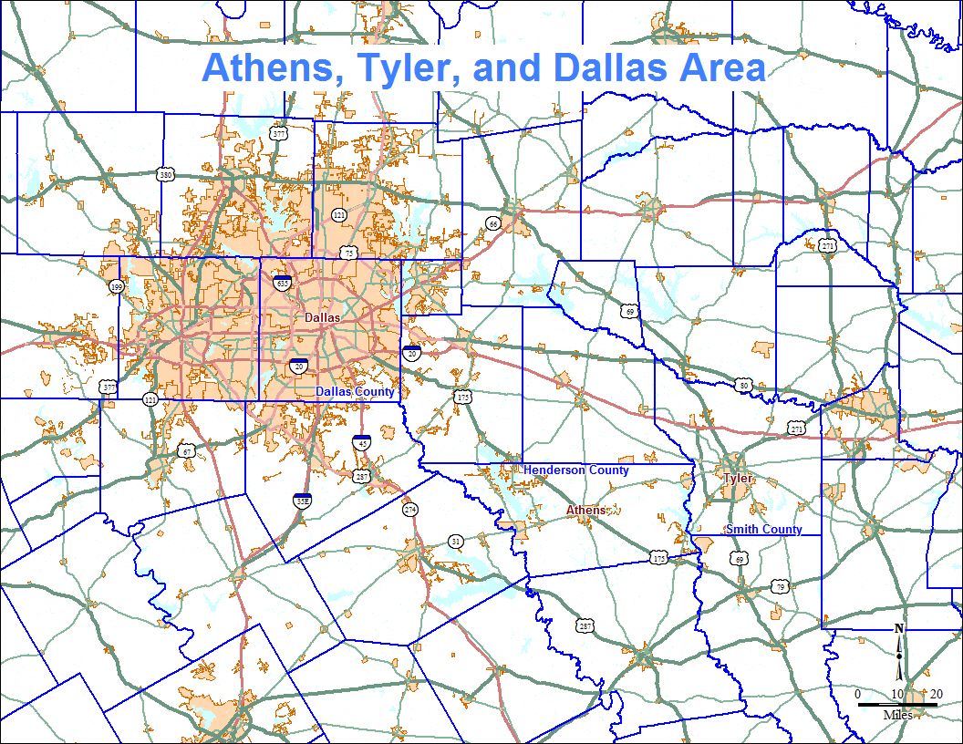

Slide 39
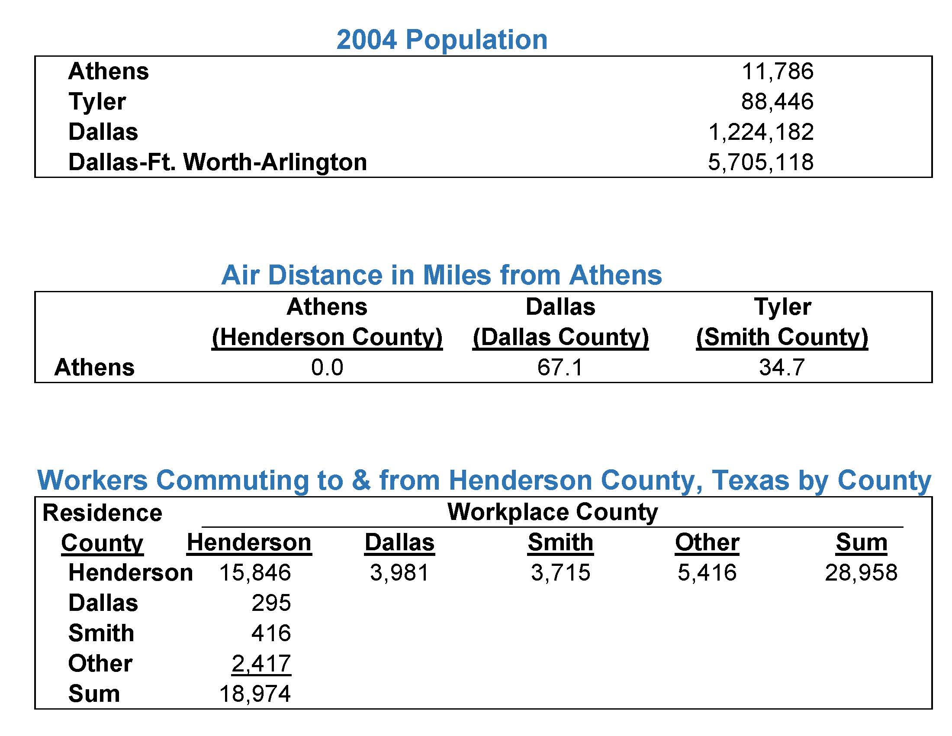

Slide 40

Allocation – “get to sell” or “sell to get”
When are allocation systems relevant?
  Demand > Supply
Role of allocation → Equalize “Days-Supply”
  Balance inventory levels to sales rates
Faster seller = more effective
Slower seller

Slide 41
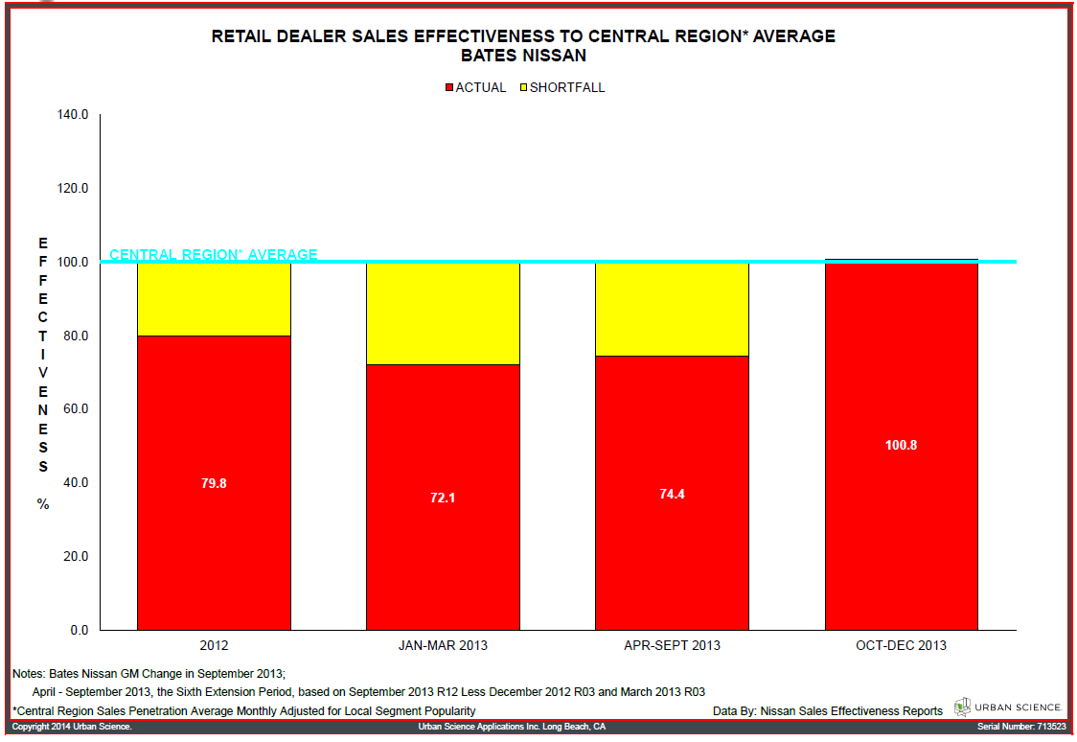
Bates Nissan – Trend

Slide 42
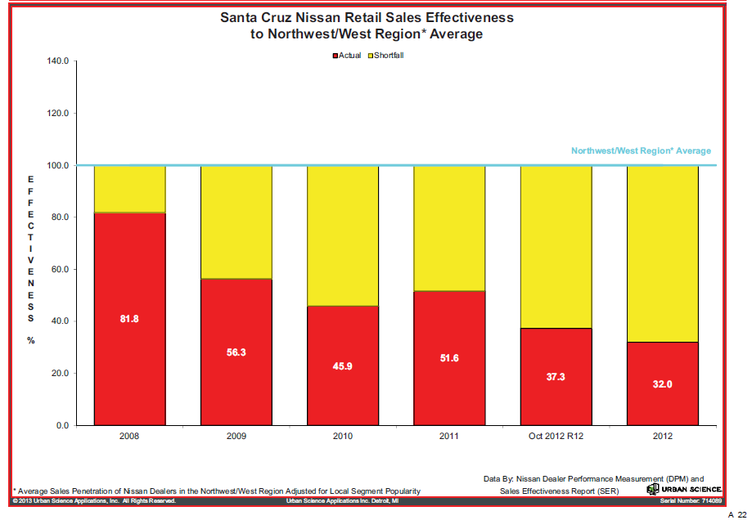
Santa Cruz Nissan – Trend

Slide 43
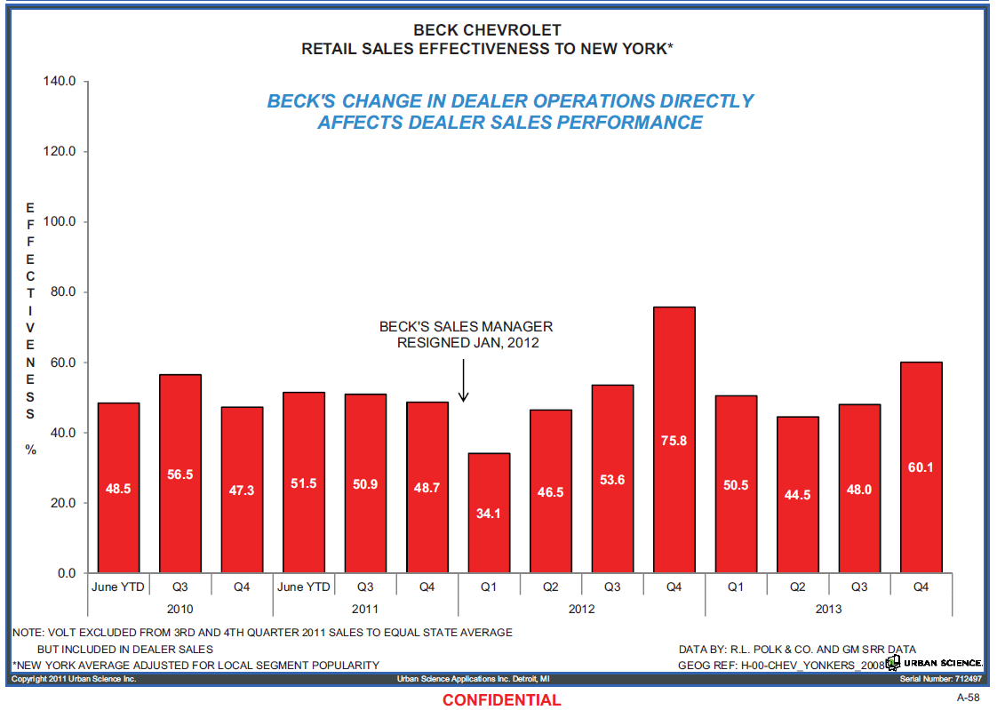
Beck Chevrolet – Trend

Slide 44
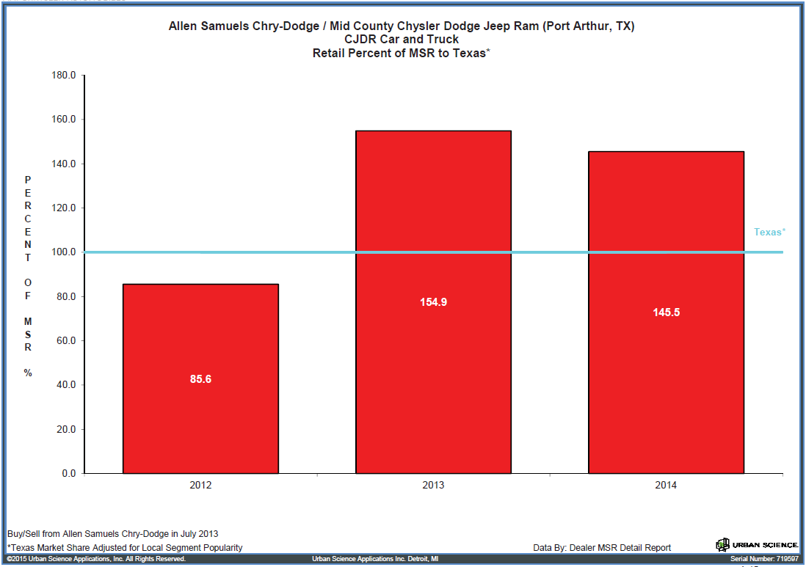
Chrysler Dealer – Port Arthur Texas

Slide 45
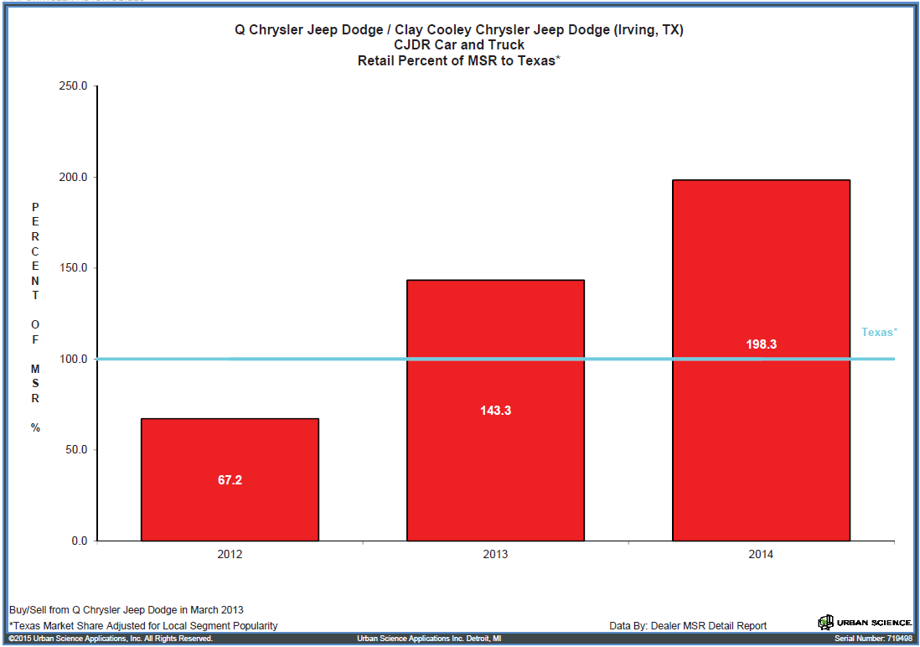
Chrysler Dealer – Irving Texas

Slide 46
What future holds?
NY State Court of Appeals, May 2016
“… the comparison data must take into account the market-based challenges that affect dealer success. “

Slide 47
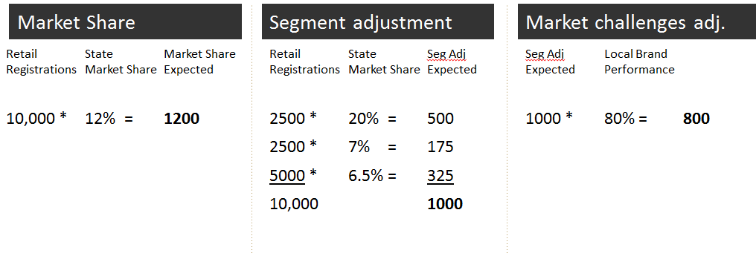
“Market-based challenges” = Local brand performance?

Slide 48
Beck Chevrolet v. GM
US Court of Appeals Second Circuit, May 2015
  “State average does not account for depressed [local] brand popularity”
  Yet a “localized average would doom the brand to mediocrity because it would not encourage better sales in poor performing areas”

Slide 49


